Slide 1
SDN and Wireless security
Saim Ghafoor
Lecture 1
Intro to SDN

Slide 2
Traditional networks
History
Blackbox networking equipment
Big name companies are managing and controlling the routing/switching devices
Proprietary silicon chips
Closed source operating system

Slide 3
Technology was not designed keeping today in mind
Massive scalability
Multi tenant networks
Virtualizations
Cloud computing
Mobility

Slide 4
Traditional network problems
Protocols are box centric (inside router and switches)
Difficult to configure correctly (consistency)
Difficult to add new features (upgrades are needed)
Difficult to debug

Slide 5
Closed systems (vendor hardware)
Stuck with given interfaces (CLI, SNMP etc)
Hard to meaningful collaborate
Vendors hesitant to open up
No way to add new feature by yourself

Slide 6
Design principles of Internet
Simple
Intelligent end-points
Distributed control
Results in huge complex network and hard to manage
Billions of computers
Tens of thousands of AS (asynchronous systems)
Great business for selling routers

Slide 7
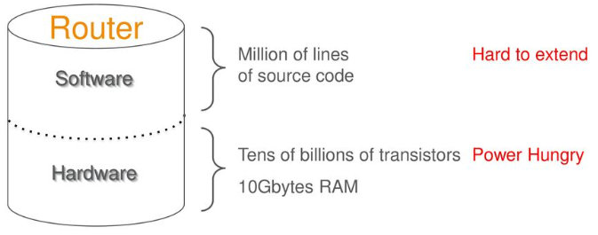
Routers are complex.
Not easily extended
Topologies cannot be changed easily like load balancing cannot be applied easily.
Hardware is stable but not flexible according to the runtime requirements.
How to achieve optimal routing dynamically? Difficult with trad. Nwks.

Slide 8
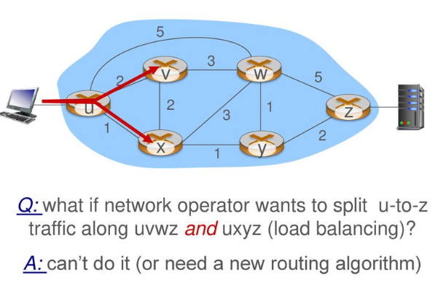
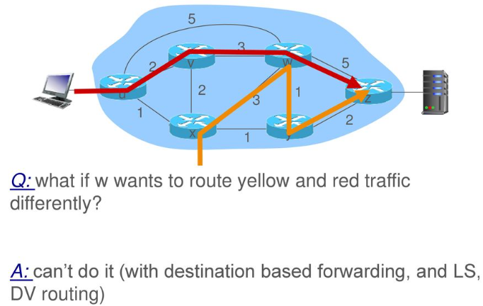

Slide 9
What is Network virtualization?
Representation of one or more logical topologies on the same infrastructure
Many different instantiations
Virtual LANs (VLANs)
Various technologies and testbeds
Today we have VMWare, different cloud platforms

Slide 10
Benefits of Network virtualization
Sharing:
multiple logical routers on a single platform
Resource isolation in CPU, memory, bandwidth, forwarding tables etc
Customizability
Customizable routing and forwarding software
General purpose CPUs for the control plane
Network processors and FPGAs for the data plane
Example: different sites with different routers shared between multiple parties may want different connectivity and topology requirements

Slide 11
Software defined networking
SDN is a framework to allow network administrators to automatically and dynamically manage and control a large number of network devices, services, topology, traffic paths, and packet handling (quality of services) policies using high-level languages and APIs.
Management includes provisioning, operating, monitoring, optimizing, and managing FCAPS (fault, configuration, accounting, performance, and security) in a multi-tenant environment.

Slide 12
SDN
A network in which the control plane is physically separate from the data plane.
A single control plane controls several forwarding devices.
Controls the network behavior from single high level control program
Deployments to solve network management problems in real networks
Two parts to the infrastructure
Control plane | Controllers, apps Defines the logics like how to forward the traffic
Data plane | Programmable switches Network devices that forwards the traffic

Slide 13
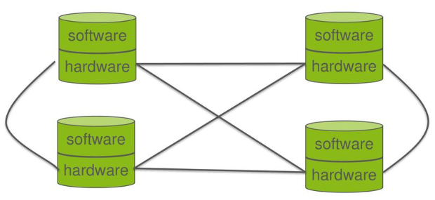
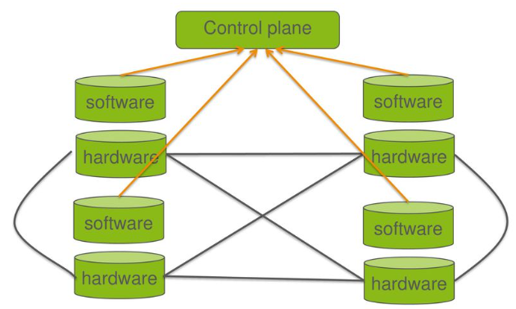
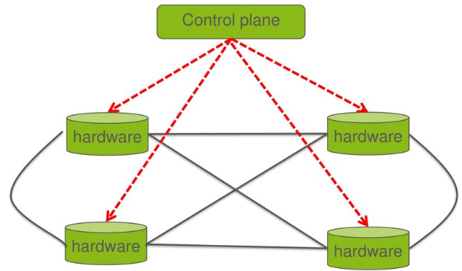
Example
Router example
Basic job of the router: receiving packets, checking the routing table, forwarding the packets out.
In order to build the routing table, the router has to understand BGP, OSPF, RIP etc
What about getting the router table from somewhere else?

Slide 14
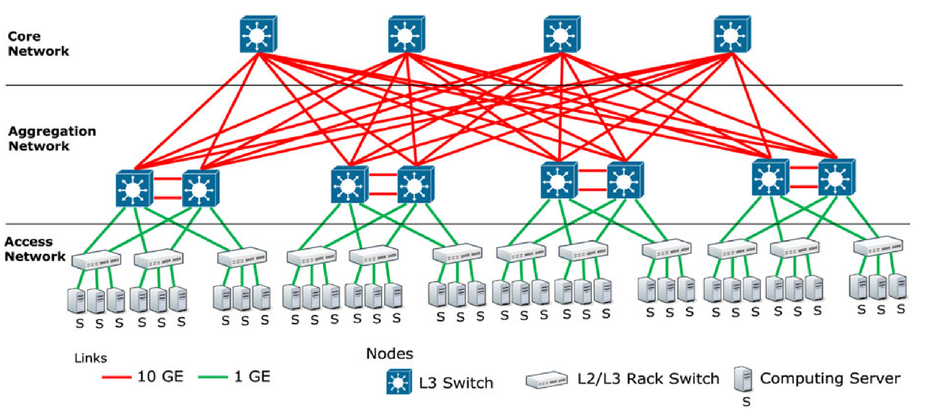
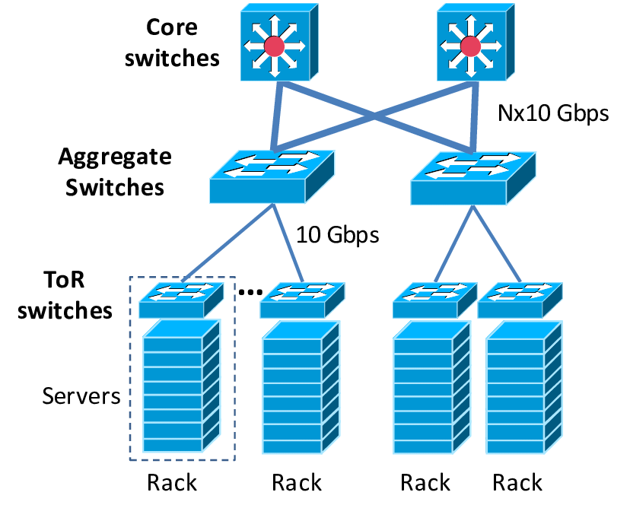
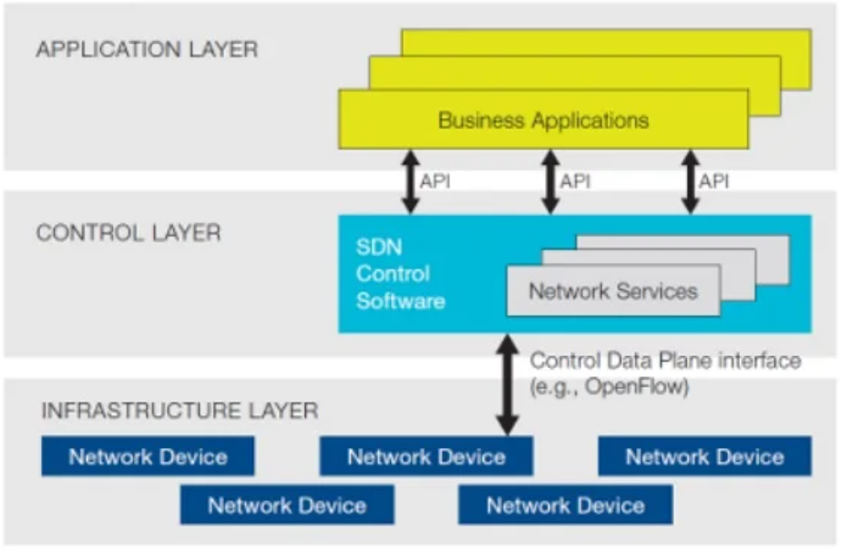
Data centre Architecture
Core layer
Aggregation layer
Access layer

Slide 15
Where it came from
Problems in the distributed configuration
Buggy, unpredictable
It would be easier, if any centralised controller will dictate the decisions and the forwarding behavior.

Slide 16
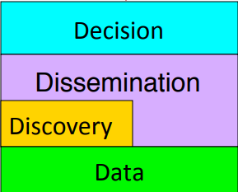
Evolution
Routing architecture
4D
Open flow: In which high level controller could control the behavior of switches.

Slide 17
Advantages
Easier to coordinate behavior among a network of devices
Load balancing, security policies
Easier to evolve – hard in conventional HW which are bundled devices
Easier to monitor from a high place – to look what is going on
Apply different CS approaches like programming, ML, mathematical models etc

Slide 18
Automation
Lowers OpEx
Reduces manual involvement
Troubleshooting, reduce downtime, policy enforcement
Provisioning and segmentation of resources
Add new workloads, sites, devices, and resources
Visibility and Monitoring
Performance
Optimise network device utilization and performance
Traffic engineering and bandwidth management
Capacity optimization
Load balancing
High utilization
Fast failure handling
Multi tenancy
Tenancies need complete control over their addresses, topology, routing, and security
Service integration
Load balancers
Firewalls
Intrusion detection Systems
Virtualization
Without worrying about where it is physically located
How much it is
How it is organized
Orchestration
Should be able to control and manage thousands of devices with one command
Programmable
Should be able to change behavior on fly
Dynamic Scaling
Should be able to change size, quantity, capacity

Slide 19
SDN Applications
Data Centres
Wide Area Backbone Networks
Enterprise networks
Internet exchange points
Home networks
Wireless networks
Internet of Things

Slide 20
In Data Centres
Hyperscale operators (Google, Microsoft, Meta, Amazon): They’ve been using SDN in their private data centres for years to optimise east-west traffic, load balancing, and multi-tenant isolation. For example, Google’s B4 WAN and Microsoft’s VL2 are SDN-based fabrics.
Enterprise data centres: Many enterprises use VMware NSX, Cisco ACI, or OpenDaylight to get centralised network control, microsegmentation, and network automation.
Network slicing and security: SDN allows granular control of traffic policies, especially for microservices-based workloads.
In Cloud
Public cloud providers: AWS, Azure, and Google Cloud all use SDN under the hood to virtualise networking.
AWS uses VPCs, security groups, and Transit Gateway implemented with SDN concepts.
Azure’s Virtual Network (VNet) and Google Cloud’s VPC rely on SDN for programmable, multi-tenant isolation.
Multi-cloud and hybrid setups: SDN controllers (like VMware NSX-T or Open vSwitch) make it possible to stretch networks across on-prem and cloud, crucial for hybrid deployments.

Slide 21
Customised hardware
Ethane
Network architecture for the enterprise
Direct enforcement of a single fine-grained network policy
Domain controller computer flow table entries based in access control polices
Custom switches: OpenWrt, NetFPGA, Linux
Problem: Requires custom switches that support ethane protocol
What are we looking for?
We are looking for something that gets us the best of both worlds: that could operate on existing protocols yet wouldn’t require customising the hardware.
OpenFlow is the answer

Slide 22
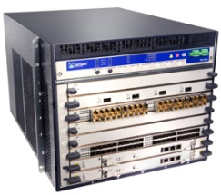
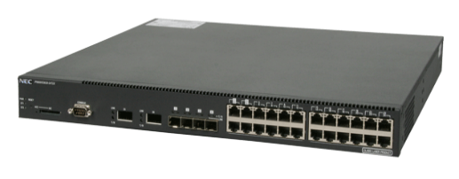
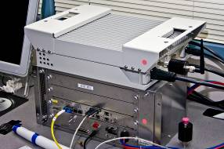
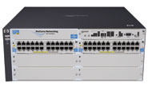
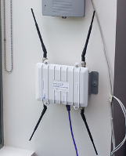

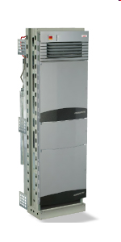

Hardware-based OpenFlow Switches
Juniper MX-series
NEC IP8800
WiMax (NEC)
HP Procurve 5400
Netgear 7324
PC Engines
Pronto 3240/3290
Ciena Coredirector

Slide 23
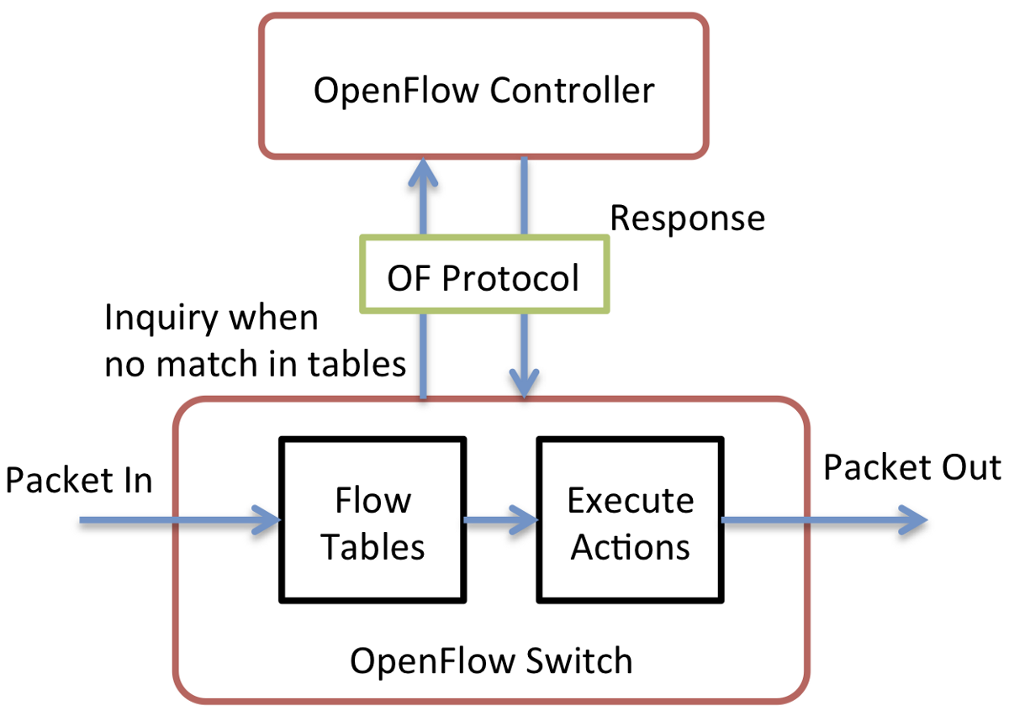
Open Hardware: OpenFlow
Take the capabilities of existing hardware and open those up such that a standard control protocol could control the behavior of that hardware.
In openflow a separate controller communicate with the switches flow table to install forwarding table entries into the switch that control the forwarding behavior of the network.
Problem: to convince the vendors to open the flow table so that it can be controlled from a separate controller.

Slide 24
OpenFlow Switches
Hardware-based OpenFlow Switches
Commercial hardware switches with OpenFlow capability
Network abstraction is realized by firmware upgrading
Show high processing speed
Have space limitation on saving the flow table entries
Approximately store 1500 flow entries (due to expensive CAM)
Not easy to upgrade
Most switches only support OpenFlow up to version 1.0
Software-based OpenFlow Switches
OpenFlow enabled software switch (runs on x86 commodity computer)
Performance is relatively low
Store large amount of flow entries with bound (theoretically)
Under active development, support most recent OpenFlow spec.
Hybrid OpenFlow Switch
A virtual switch with specialized hardware device
Much faster than software-based switches

Slide 25
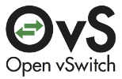
Software-based OpenFlow Switches
OpenvSwitch (OVS)
Overview
A virtual switch or Virtual Ethernet Bridge (VEB)
User-space: configuration, control
Kernel-space: datapath (included in main Linux kernel from v3.3)
Features
Support OpenFlow protocol
Support multiple tunneling protocols
VxLAN, Ethernet over GRE, IPsec, GRE over IPsec
Fine-grained QoS
Main components
ovs-vswitchd: a daemon that implements the switch
ovsdb-server: lightweight database server that ovs-vswitch queries to
ovs-vsctl: a utility for querying and updating the config. of ovs-vswitchd
ovs-dpctl: a tool for configuring and monitoring the switch kernel module
ovs-ofctl: a tool for monitoring and administering OpenFlow switches
ovs-controller: a simple OpenFlow controller reference implementation
openvswitch.ko: OpenvSwitch switching datapath

Slide 26
Types of SDN
Open SDN:
Open SDN uses open-source technologies to implement the SDN ecosystem. OpenFlow protocol is often used to control the communication between the controller and the physical and virtual devices on the data plane.
API-based SDN:
API SDN uses application programming interfaces (APIs) to control the movement of data on the network. APIs provide the means to program the behavior of the SDN controller and network devices.
Hybrid Model:
Hybrid Model SDN combines the elements of software-defined networking with traditional networking protocols.
Overlay SDN (hypervisor-based):
SDN overlay refers to a networking approach that creates a virtual overlay on top of an existing physical network infrastructure.

Slide 27
In conclusion:
The control and data plane should be decoupled
Using existing protocols makes deployment easier
Open hardware allows decoupling of control
The interest in SDN has increased over the past 10 years and many ideas have evolved since its proposal in 2009.
Is OpenFLow an SDN? No, OF is just an instantiation of SDN.

